Slide 1
VISUAL BASIC
PROJECTS

Slide 2
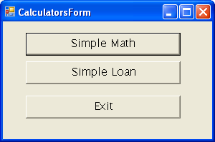
VB.NET Projects
Build a Calculator Project having three forms. The main form has three buttons: ‘Simple Math’, ‘Simple Loan’, and ‘Exit’. Add the existing forms (Loan Calculator form and Math Calculator form) which gets activated when proper buttons of the Main form are selected.

Slide 3
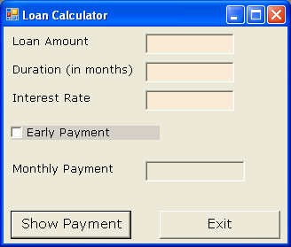
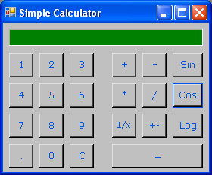
VB.NET Projects
Build a Loan Calculator Project
Build a Math Calculator Project

Slide 4
Building A Loan Calculator
Formula To Calculate Monthly Interest:
Monthly Payment = Pmt(MonthlyRate, Period, Amount, FutureValue, Due)
Monthly Rate: If interest rate = 14.5, then monthly rate to be supplied will be 0.145 /12
Period: Period is the number of months taken as input.
Amount: The value of amount has to taken as a negative value. It is because we don’t have the money now. We are borrowing the money we owe to the bank.
Future value: Future Value is always 0. It would be positive value for an investment. It means what the loan will be worth when it is paid off.
Due:The value of Due can be one of the constants – DueDate.BegOfPeriod and DueDate.EndOfPeriod.

Slide 5
Executable Files
An executable file is a binary file that contains instructions only the machine can understand and execute.
The commands stored in the executable file are known as machine language.
Along with the executable file, an application requires support files. The executable file will run on the system on which it was developed, because the support files are there.
Under the project’s file, there are two folders named Bin and Obj. Inside the Obj folder there is a subfolder named Debug. This is where the executable file resides having the same name as the project name and has the extension .exe.
Distributing just an executable file isn't going to be any good, because the executable file requires support files. If the latter are not installed on the target system, then the executable file is not going to work. The file will be executed only on a system that has Visual Studio.NET on it.

Slide 6
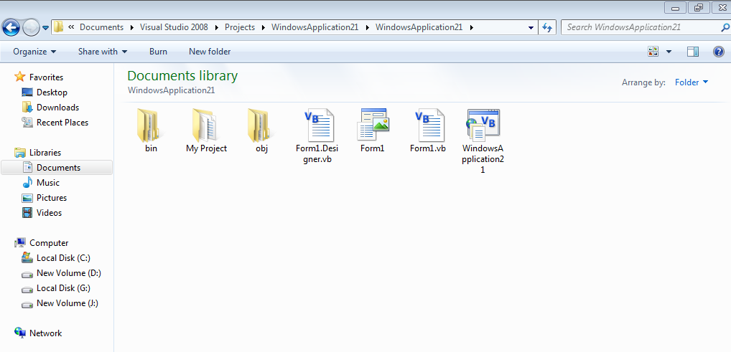
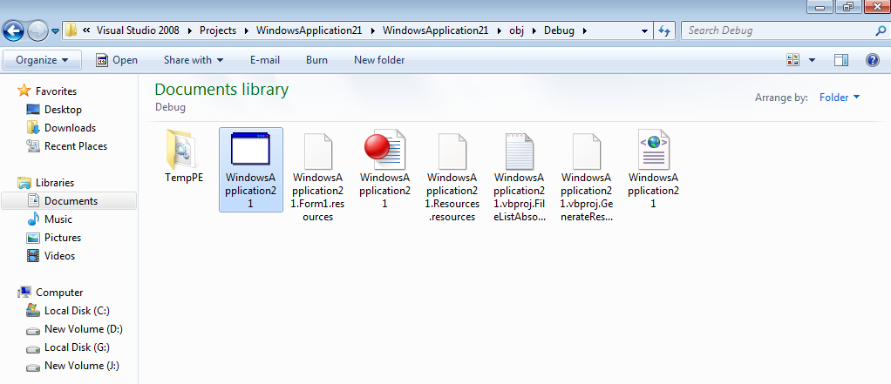
Executable File

Slide 7
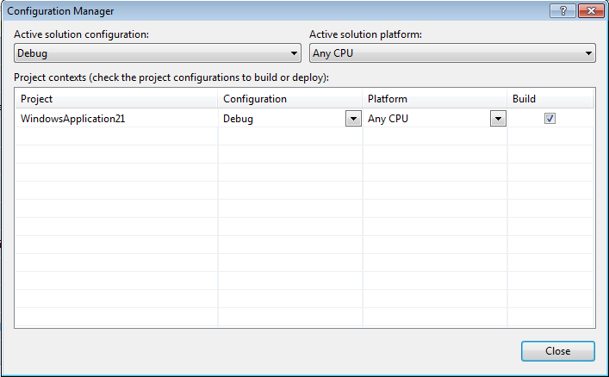
The folder Debug contains the Debug version of the executable. To change the project’s configuration, select Build > Configuration Manager. Change the setting of the configuration to Release. Build the project again and check that under the Obj folder, a Release subfolder will be created.
Difference between the two versions of the executable file:
Debug – Debug files contain symbolic debug information.
Release – The Release configuration executes faster as it does not contain any debug information.

Slide 8
Windows Installer File
Eventually, all the support files will become part of the operating system, and then we will be able to distribute a single EXE file (or a number of files). This hasn’t happened with Windows 2000 or Windows XP and won’t for some time. Until it does, we must provide our own installer.
A setup project creates a Windows installer file ( a file with extension .msi), which contains the executable(s) of the application, Registry entries, installation instructions and so on.
The resulting MSI file is usually quite long, and this is the file we can distribute to end users.
To create a Windows installer, we must add a Setup project to our solution.

Slide 9
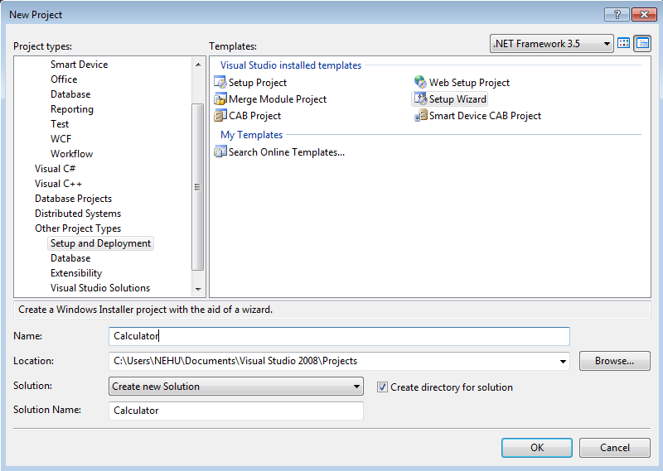
Windows Installer
Creating the Windows Installer
Running the Windows Installer
Verifying the Installation
Go to File -> New- > Project

